Slide 1

CSE 473
Pattern Recognition

Slide 2
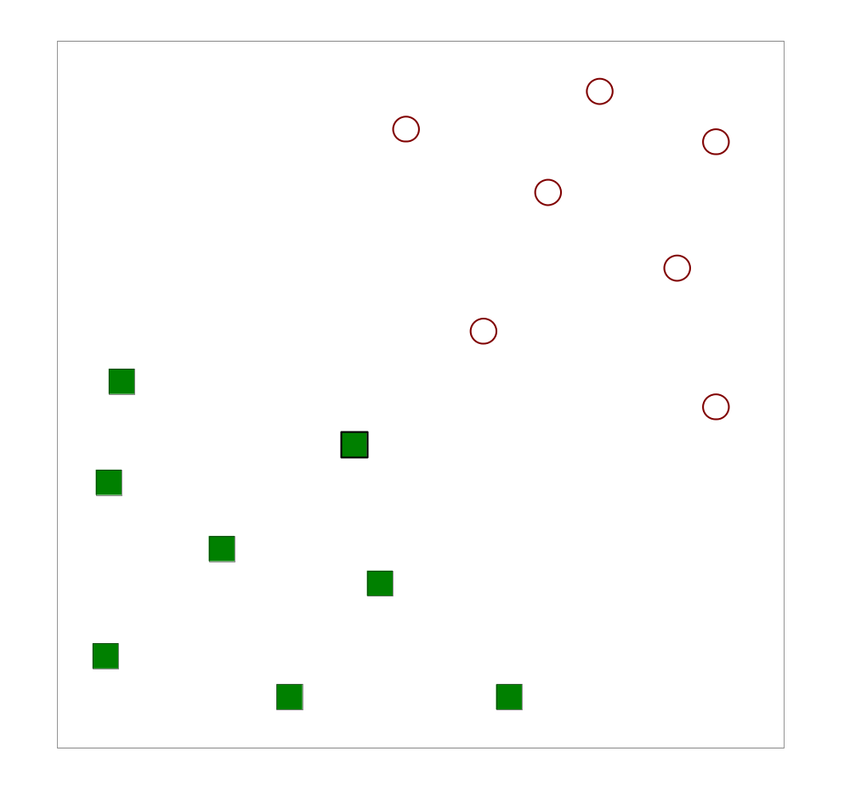
Two-Class case again
Let, we have N training samples

Slide 3
Two-Class case again
Let, we have N training samples
Find a linear hyperplane (decision boundary) that will separate the data

Slide 4
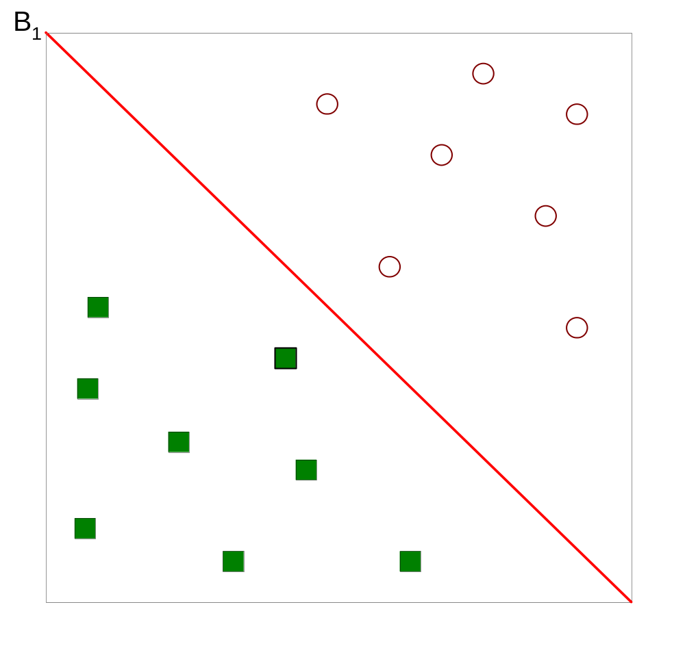
Two-Class case again
B₁
One Possible Solution

Slide 5
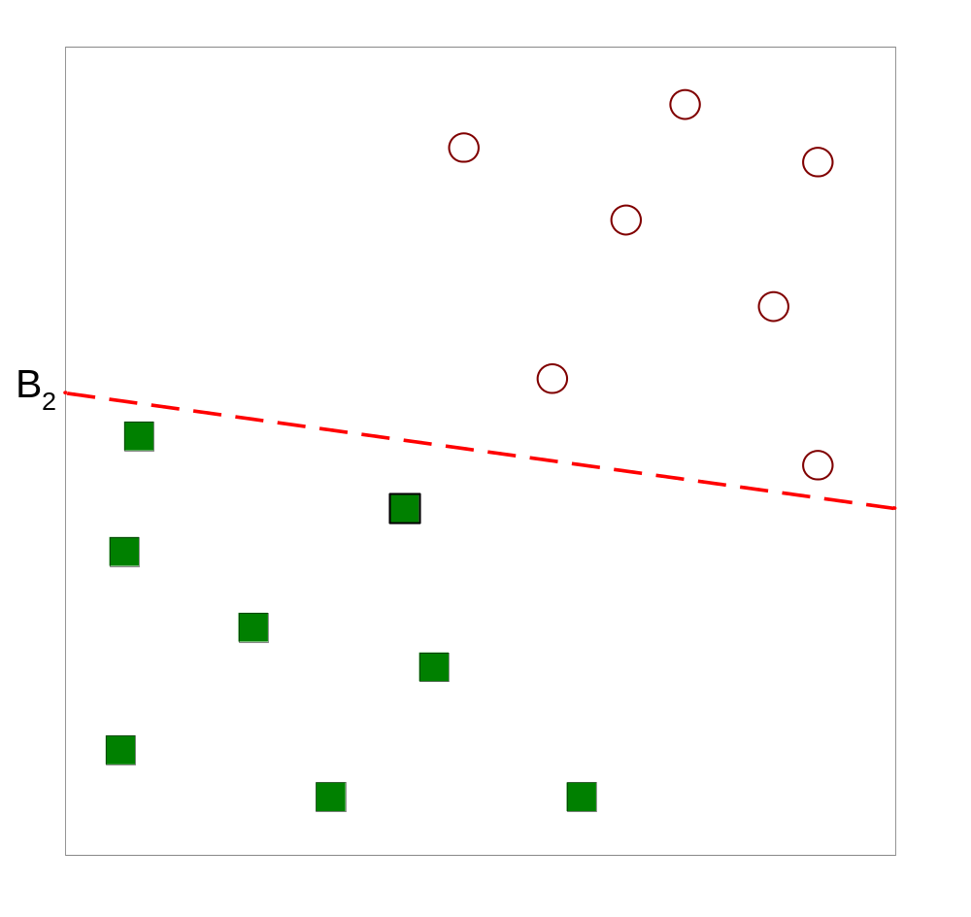
Two-Class case again
B₂
Another possible solution

Slide 6
Two-Class case again
B₂
Other possible solutions

Slide 7
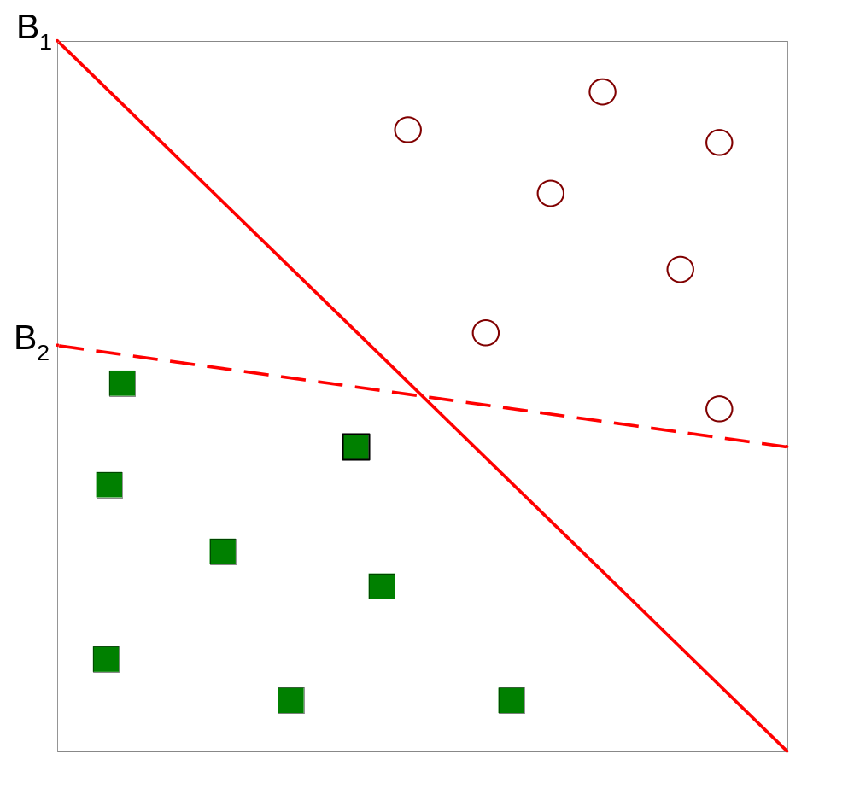
Two-Class case again
B₁
B₂
Which one is better? B₁ or B₂?
How do you define better?

Slide 8
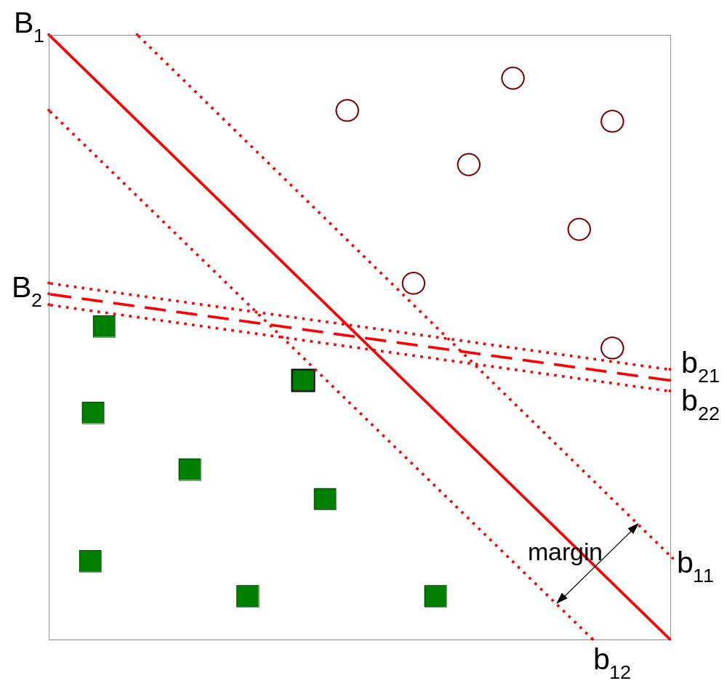
Two-Class case again
B₁
B₂
b₂₁
b₂₂
b₁₁
b₁₂
Find hyperplane maximizes the margin => B1 is better than B2

Slide 9
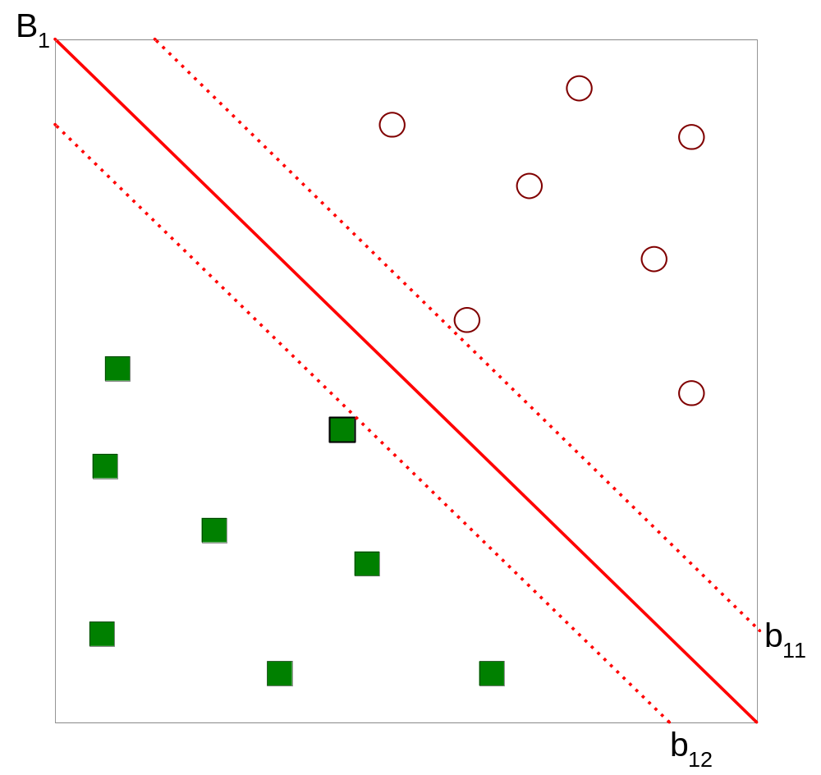

Two-Class case again
B₁

Slide 10


Two-Class case again
B₁
b₁₁
b₁₂

Slide 11
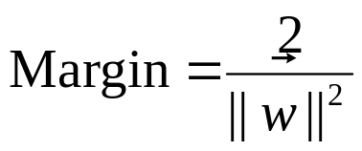
Two-Class case again
B₁
b₁₁
b₁₂

Slide 12
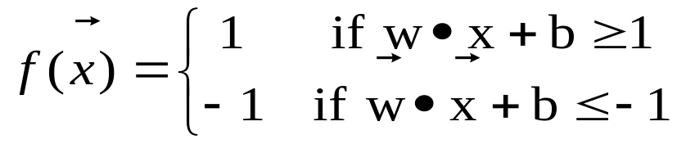
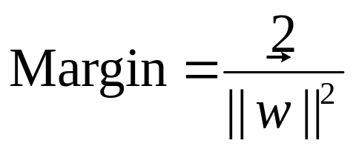
Two-Class case again
B₁
b₁₁
b₁₂

Slide 13
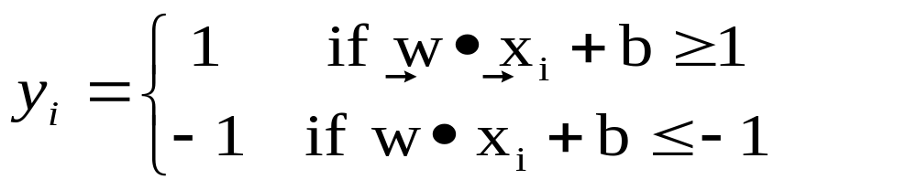
Support Vector Machine
We want to maximize:
  subject to the following constraints:

Slide 14
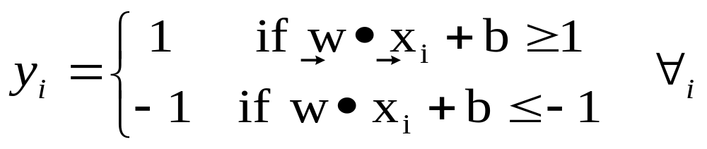
Support Vector Machine
We want to maximize:
  subject to the following constraints:

Slide 15
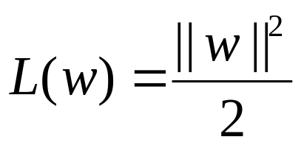
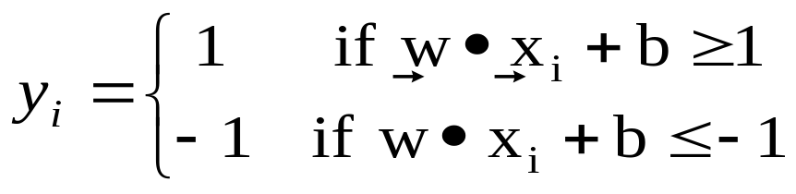
Support Vector Machine
We want to maximize:
  Which is equivalent to minimizing:
  subject to the following constraints:

Slide 16
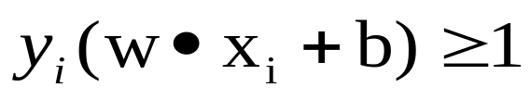
Support Vector Machine
The Expression
can be written as

Slide 17
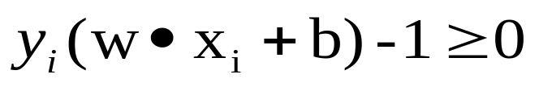
Support Vector Machine
The Expression
can be written as
We can say :
  minimize:
  Subject to:
or

Slide 18
Support Vector Machine
is a quadratic equation
Solving for w and b is not easy

Slide 19
Support Vector Machine
is a quadratic equation
Solving for w and b is not easy
What happens if w =0?

Slide 20
Support Vector Machine
is a quadratic equation
Solving for w and b is not easy
What happens if w =0?
Some of
may be infeasible

Slide 21
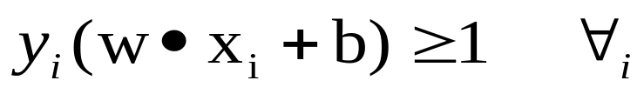
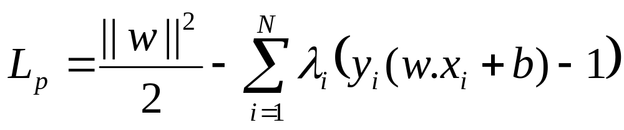
Support Vector Machines
  minimize:
  Subject to:
Use Lagrange function:

Slide 22
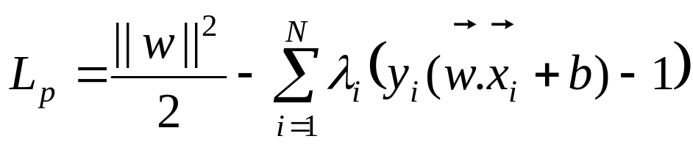
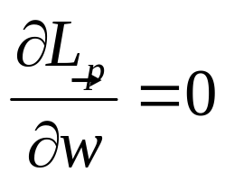
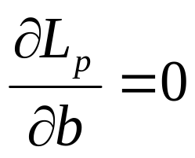
Support Vector Machines
Lagrange function:
New constraints are:

Slide 23
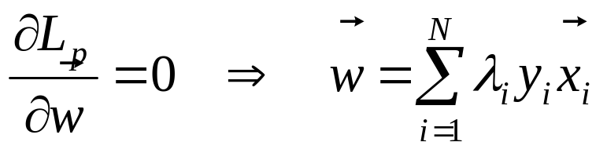
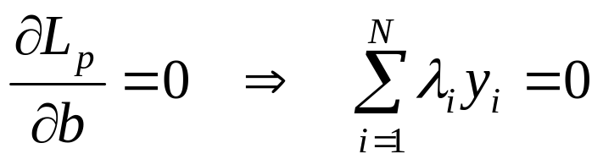
Support Vector Machines
Lagrange function:
New constraints are:

Slide 24
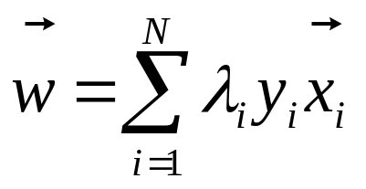
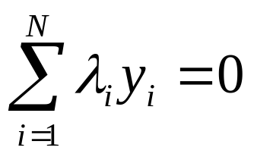
Support Vector Machines
Lagrange function:
constraints are:
Still not solvable, many variables

Slide 25
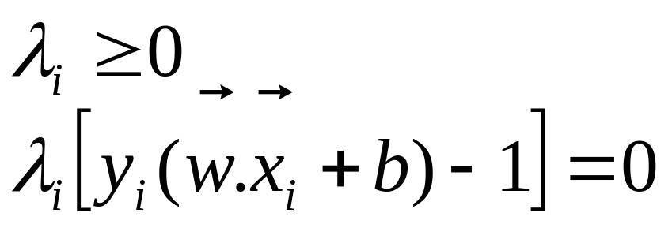
Support Vector Machines
Use Lagrange function:
constraints are:
From Karush-Kuhn_Tucker Transform,

Slide 26
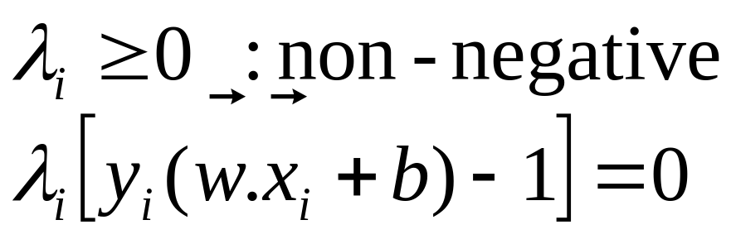
Support Vector Machines

Slide 27
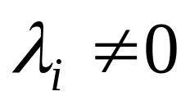
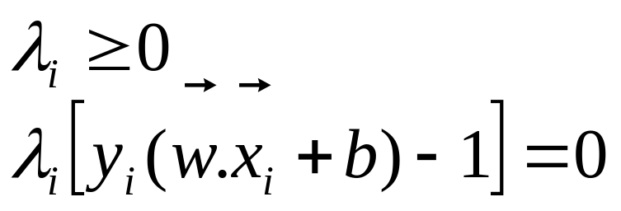
Support Vector Machines
B₁
Support Vectors

Slide 28
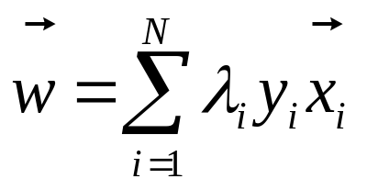
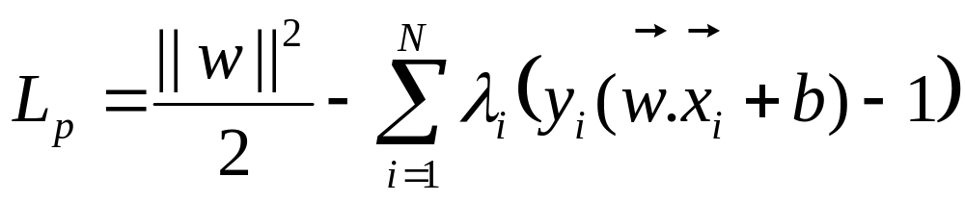
Support Vector Machines
Replace w with λ’s in L_{p} :
put
and
in

Slide 29
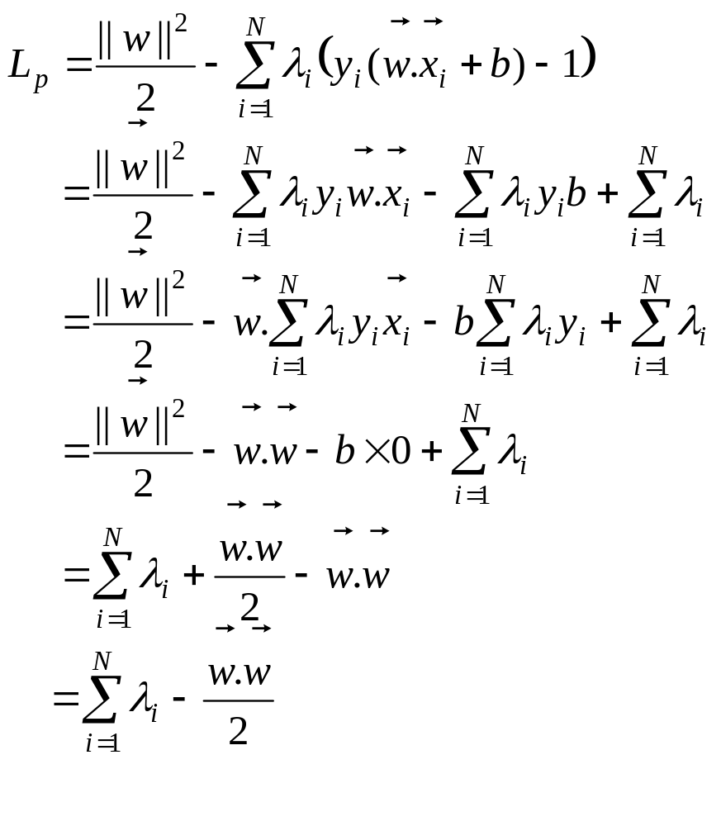

Slide 35
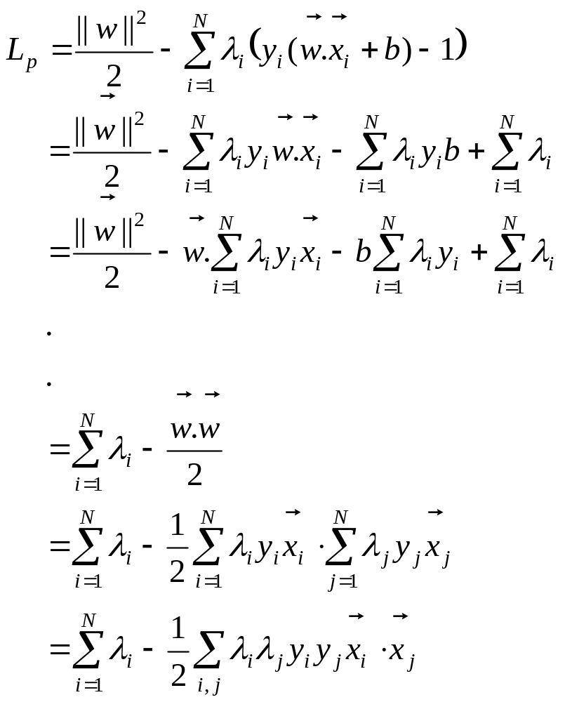

Slide 37
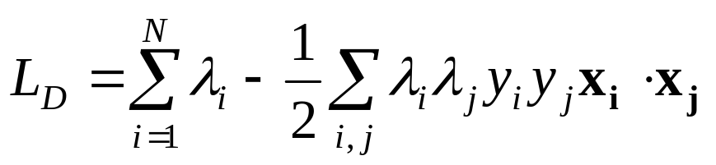
Support Vector Machines
Replace w with λ’s in L_{p} :
The dual to be maximized:

Slide 38
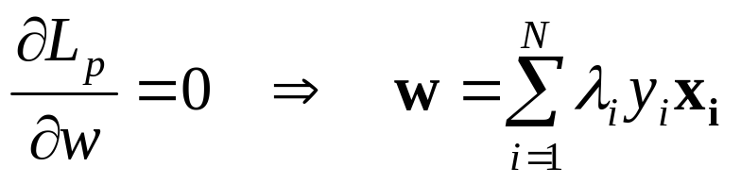

Support Vector Machines
After solving λ’s :
  Find w and b:

Slide 39

Support Vector Machines
Classify an unknown example z:

Slide 40
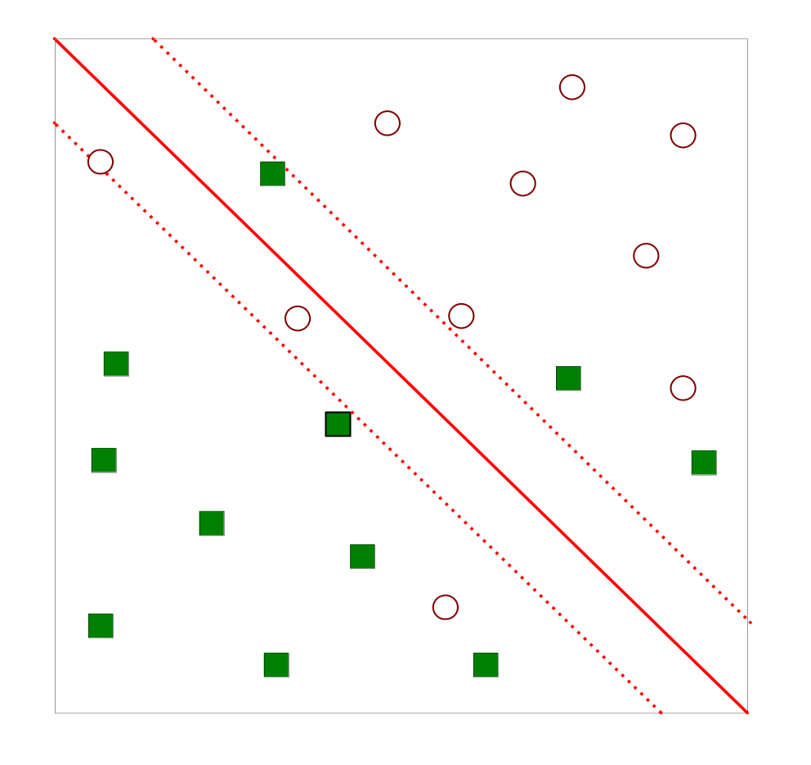
Support Vector Machines
What happens, if the problem is not linearly separable?

Slide 41
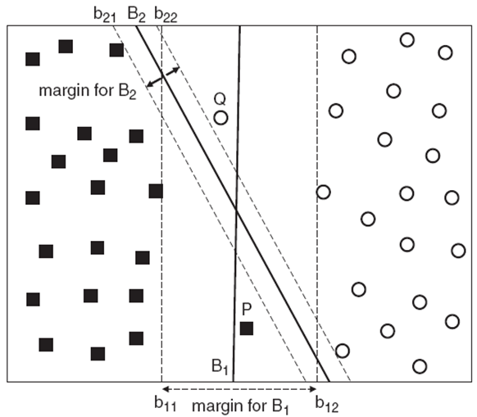
Linear SVM for Non-separable Case

Slide 42
Linear SVM for Non-separable Case

Slide 43
Linear SVM for Non-separable Case

Slide 44
Linear SVM for Non-separable Case
Which one is better: B₁ or B₂?

Slide 45
Linear SVM for Non-separable Case
Target: use Linear SVM to separable non-separable samples
How: use soft margin
Tolerable to small training error
Need a trade-off between margin and training errors

Slide 46
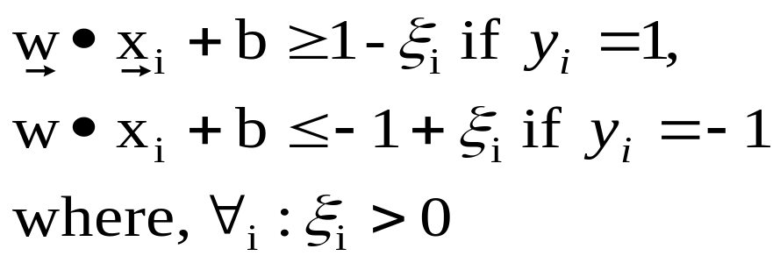
Linear SVM for Non-separable Case
P and Q no longer satisfy previous constraints
Introduce slack variables (ξ) to relax the constraints

Slide 47
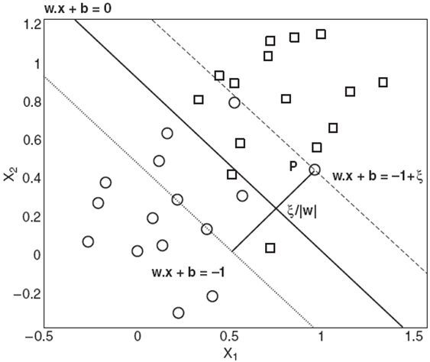
Linear SVM for Non-separable Case
What ξ indicates?

Slide 48
Linear SVM for Non-separable Case
Slack variables (ξ) estimates the error of decision boundary

Slide 49
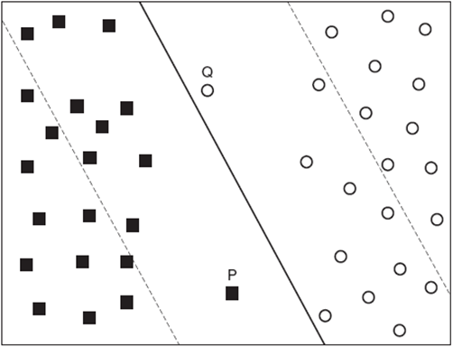
Linear SVM for Non-separable Case
trade off:
  too large margin
  too many misclassification

Slide 50
Linear SVM for Non-separable Case
Use Slack variables (ξ) in objective function

Slide 51
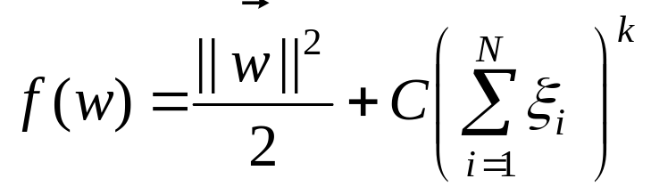
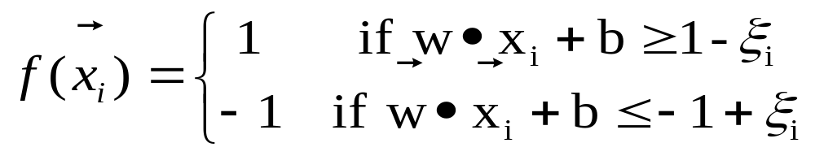
Linear SVM for Non-separable Case
  The new objective function is
  Subject to:

Slide 52
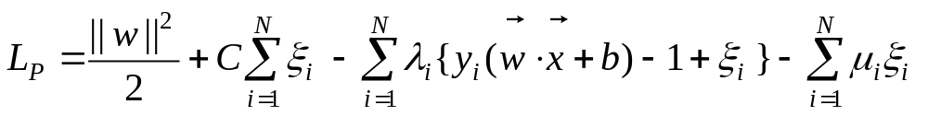
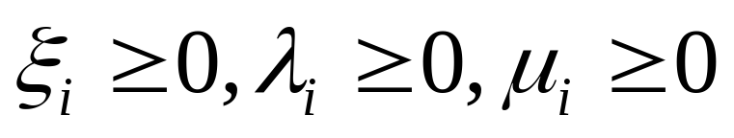
Linear SVM for Non-separable Case
  The Lagrange primal using new objective function is
  Subject to:

Slide 53
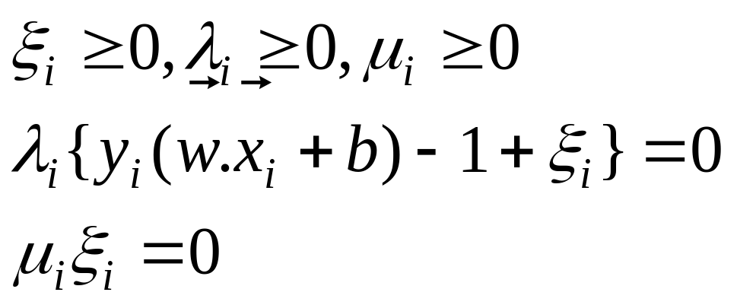
Linear SVM for Non-separable Case
  The Lagrange primal using new objective function is
  Subject to:

Slide 54
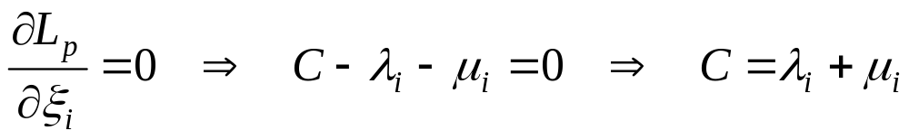
Linear SVM for Non-separable Case
  The Lagrange primal
  First derivative w. r. to variables:

Slide 55
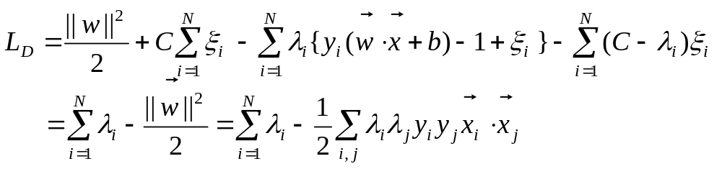
Linear SVM for Non-separable Case
  The Lagrange primal
  The dual is

Slide 56
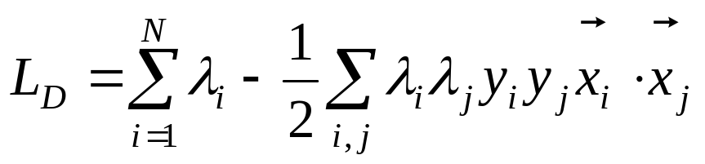
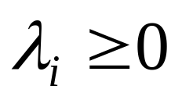

What is the Difference?
In linearly separable cases:
  This means λ’s are unbounded
In linearly non-separable cases:

Slide 57
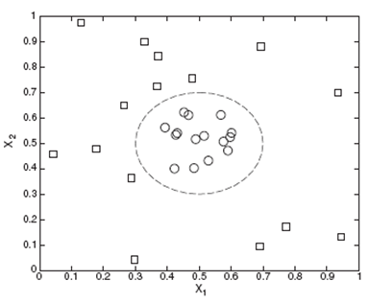
What’s Next?
How can we separate these examples?
  Non-linear SVM
  Neural Network

Slide 58
Nonlinear Classifier

Slide 59

Review of Perceptron’s Capability
Recall the AND or OR functions
x₁ | x₂ | AND |  | OR
0 | 0 | 0 |  | 0
0 | 1 | 0 |  | 1
1 | 0 | 0 |  | 1
1 | 1 | 1 |  | 1

Slide 60
Review of Perceptron’s Capability
Recall the AND or OR functions
x₁ | x₂ | AND | Class | OR | Class
0 | 0 | 0 | B | 0 | B
0 | 1 | 0 | B | 1 | A
1 | 0 | 0 | B | 1 | A
1 | 1 | 1 | A | 1 | A

Slide 61
Review of Perceptron’s Capability
Can you remember the perceptron’s capability to separate them?
x₁ | x₂ | AND | Class | OR | Class
0 | 0 | 0 | B | 0 | B
0 | 1 | 0 | B | 1 | A
1 | 0 | 0 | B | 1 | A
1 | 1 | 1 | A | 1 | A

Slide 62
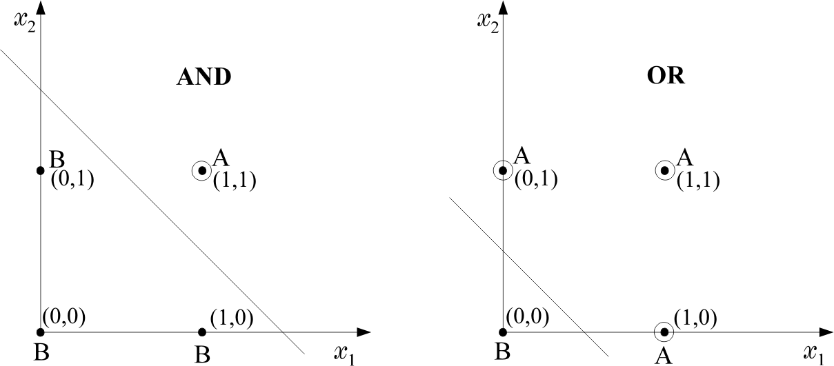
Review of Perceptron’s Capability

Slide 63
Review of Perceptron’s Capability

Slide 64
Review of Perceptron’s Capability
x₁ + x₂ -1/2 =0
x₁
1
x₂
1
-1/2

Slide 65
Review of Perceptron’s Capability
x₁ + x₂ -3/2 =0
x₁
1
1
x₂
-3/2

Slide 66
Review of Perceptron’s Capability
x₁ | x₂ | XOR | Class
0 | 0 | 0 | B
0 | 1 | 1 | A
1 | 0 | 1 | A
1 | 1 | 0 | B
Now recall the XOR function

Slide 67

Review of Perceptron’s Capability
x₁ | x₂ | XOR | Class
0 | 0 | 0 | B
0 | 1 | 1 | A
1 | 0 | 1 | A
1 | 1 | 0 | B
Now recall the XOR function

Slide 68

Review of Perceptron’s Capability
For the XOR problem, draw two lines instead of one

Slide 69

Review of Perceptron’s Capability
B
A
g₂(x)
g₁(x)
B
Each of them is realized by a perceptron.
Find the position of x w.r.t. both lines, based on the values of y₁, y₂.

Slide 70

Review of Perceptron’s Capability
1st phase
x₁ | x₂ | y₁ | y₂
0 | 0 | - | -
0 | 1 | + | -
1 | 0 | + | -
1 | 1 | + | +
Equivalently: The computations of the first phase perform a mapping

Slide 71
Review of Perceptron’s Capability
1st phase
x₁ | x₂ | y₁ | y₂
0 | 0 | 0(-) | 0(-)
0 | 1 | 1(+) | 0(-)
1 | 0 | 1(+) | 0(-)
1 | 1 | 1(+) | 1(+)
Equivalently: The computations of the first phase perform a mapping

Slide 72
Review of Perceptron’s Capability
1st phase
x₁ | x₂ | y₁ | y₂
0 | 0 | 0 | 0
0 | 1 | 1 | 0
1 | 0 | 1 | 0
1 | 1 | 1 | 1
Equivalently: The computations of the first phase perform a mapping

Slide 73
Review of Perceptron’s Capability
1st phase |  |  |  | 2nd phase
x₁ | x₂ | y₁ | y₂
0 | 0 | 0 | 0 | B(0)
0 | 1 | 1 | 0 | A(1)
1 | 0 | 1 | 0 | A(1)
1 | 1 | 1 | 1 | B(0)
Equivalently: The computations of the first phase perform a mapping

Slide 74
Review of Perceptron’s Capability
1st phase |  |  |  | 2nd phase
x₁ | x₂ | y₁ | y₂
0 | 0 | 0 | 0 | B(0)
0 | 1 | 1 | 0 | A(1)
1 | 0 | 1 | 0 | A(1)
1 | 1 | 1 | 1 | B(0)
Now classify based on [y₁, y₂]

Slide 75



Review of Perceptron’s Capability
The decision is now performed on the transformed data.
This can be performed via a second line, which can also be realized by a perceptron.

Slide 76

Two phases, Two Layers
Computations of the first phase perform a mapping that transforms the nonlinearly separable problem to a linearly separable one.
The architecture

Slide 77


Two Layer Perceptron
hidden layer
output layer
nodes realizes hyper planes:
Activation function:

Slide 78
Classification Capabilities of Two Layer Perceptron
The mapping performed by the first layer neurons is onto the vertices of the unit side square, e.g.,
(0, 0), (0, 1), (1, 0), (1, 1).

Slide 79


Classification Capabilities of Two Layer Perceptron
Consider a more general case,

Slide 80
Classification Capabilities of Two Layer Perceptron
maps a vector onto the vertices of the unit side hypercube, Hp
mapping is through p neurons each realizing a hyper plane.
The output of each of these neurons is 0 or 1

